Slide 1
S-9: Corrosion, Dry and Wet corrosions

Slide 2
Corrosion
Corrosion refers to the unwanted deterioration of a metal, starting from its surface, as a result of chemical reactions between it and the surrounding environment.
Example: Rusting of iron
Most of the corrosions involve in the formation of metal oxides. This means that any metal (with the exception of gold) will be oxidized in any environment that contains oxygen.
There are several types of corrosion, including wet corrosion and dry corrosion.
Dry corrosion occurs when there is no water or moisture to aid the corrosion, and the metal gets oxidized with the atmosphere alone.
Wet corrosion of metals occurs through electron transfer, involving two processes, oxidation and reduction

Slide 3
There are many factors that dictate how corrosive an environment is.
The amount of oxygen available to form corrosion products or the presence of water or moisture which greatly accelerate the rate of corrosion.
Another is the presence of other elements, ions and compounds that can limit or enhance corrosion rates. Therefore corrosion rates are often considered in different atmospheres: industrial, rural and marine.

Slide 4
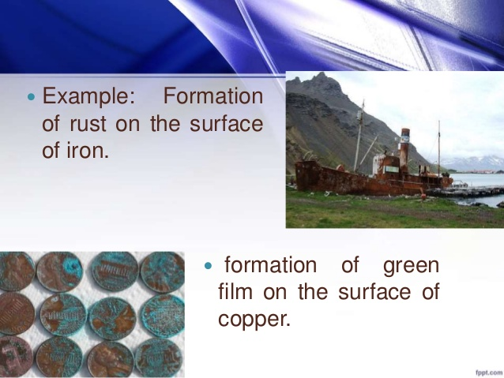

Slide 5
Dry corrosion
It is also known as chemical corrosion
This corrosion is due to the direct chemical attack on the metal surface by the atmospheric gases such as
oxygen, halogen, hydrogen sulphide, sulfur dioxide
Different types:
Oxidation corrosion
Liquid metal corrosion
Corrosion by other gases

Slide 6
Oxidation corrosion
Direct attack of oxygen on metal surfaces in the absence of moisture
e.g., Alkali metals (Li, Na, K etc.) and alkaline metals (Mg, Ca etc.)
are rapidly oxidized at low temperature
Mechanism:
Oxidation takes place at the surface of metal forming metal ions
M M^{n+} + ne-
Oxygen is converted to oxide by accepting the electron from the metal
(n/2) O₂ + 2ne⁻ nO²⁻
M + O₂ Metal oxide (corrosion product)

Slide 7
Liquid metal corrosion
When a liquid metal is allowed to flow over a solid metal at high
temperature is called liquid metal corrosion
This is due to the chemical action of flowing liquid metal on solid metal
or alloy
Example: In nuclear reactor, sodium metal is used as the coolant and leads
to corrosion of Cd
Corrosion by other gases
Some gases reacts with certain metal and forms a protective or non-protective
layer on metallic surface. Thus, metals undergo corrosion due to the reaction of
gases.
Ex: When steel is exposed to hydrogen gas at high temperature
H₂ + heat 2 H, C + 4 H CH₄
The presence of methane gas in the voids of steel develops high pressure, which causes
cracking of steel.

Slide 8
Wet corrosion
Also known as electrochemical corrosion
This type of corrosion occurs due to the flow of electron from the metal anodic surface towards cathodic area through
a conducting solution
Electrochemical corrosion involves
The formation of anodic and cathodic areas or parts in contact with each other
presence of a conducting medium
corrosion of anodic areas only

Slide 9
Types of Wet corrosion
Galvanic corrosion
Concentration cell corrosion
Galvanic corrosion
When two dissimilar metals (e.g., Zn and Cu) are electrically connected and exposed to an electrolyte, the metal higher in electrochemical series undergoes corrosion
Mechanism:
In acidic solution, the corrosion occurs by the hydrogen evolution process, whereas in neutral or slightly alkaline solution, oxygen absorption occurs.
The electron-current flows from the anode metal, Zn to cathode metal Cu.
At anode: Zn Zn²⁺ + 2e⁻ (oxidation)

Slide 10
Concentration cell corrosion
This is due to the electrochemical attack on the metal surface exposed
to an electrolyte of varying concentration or of varying aeration
When one part of metal is exposed to a different air concentration from
the other part
If a metal is partially immersed in a conducting solution, the metal part
above the solution is more aerated and becomes cathodic.
The metal part inside the solution is less aerated and thus becomes anodic
and suffers from corrosion
At anode: M M²⁺ + 2e⁻ (oxidation)
At cathode: ½ O₂ + H₂O + 2e⁻ 2OH⁻

Slide 11
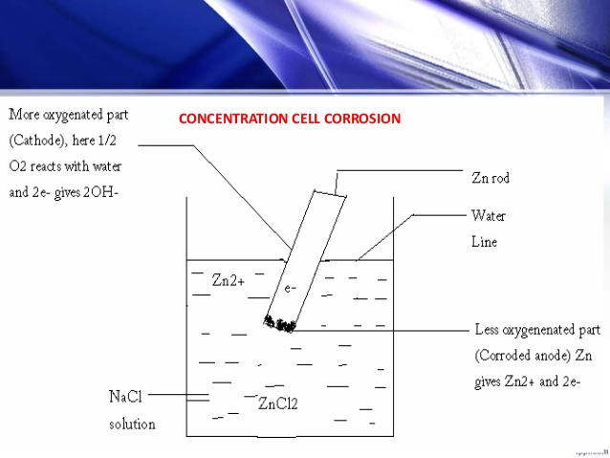
Concentration cell corrosion

Slide 12
